Slide 1





Current Research Regarding Time-out
An Autism in Education (AIE) Partnership Information Paper

Slide 2
Why was it important to write this paper?
Time-out is a tricky subject.
Do we really want to dive into that discussion?
Shouldn’t we focus on positive, proactive support plans?
. . . but sometimes behaviour happens.

Slide 3
Why does this matter?
Learning
  learning can only happen in a safe and secure environment
Safety
  keeping people safe (all students and staff)
Effectiveness
  Strategies that are being called “time-out” are being used in schools and may or may not be doing what they are intended to do

Slide 4
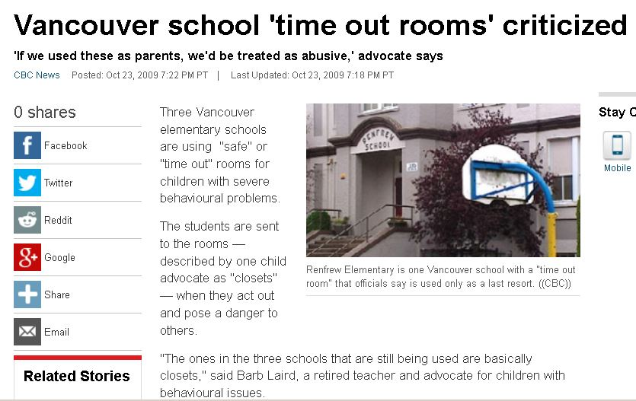
Retrieved from: http://www.cbc.ca/news/canada/british-columbia/vancouver-school-time-out-rooms-criticized-1.849217 April 13, 2015

Slide 5
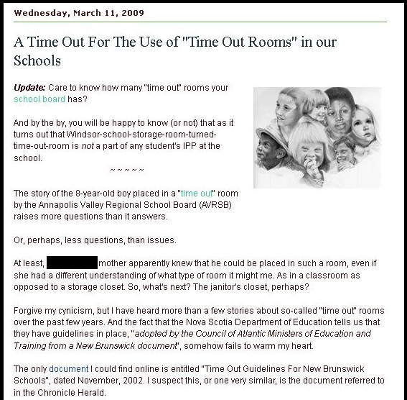
Retrieved from: http://specialneeds-ns.blogspot.ca/2009/03/time-out-for-use-of-time-out-rooms-in.html April 13, 2015

Slide 6
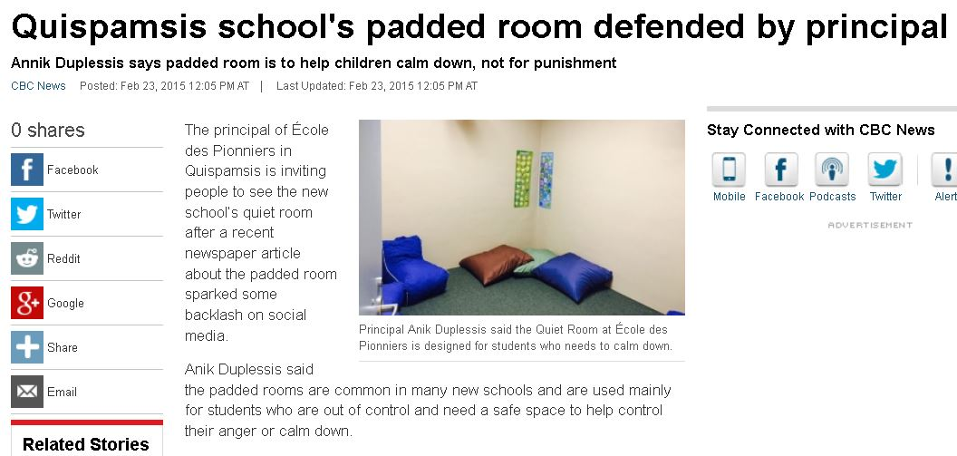
Retrieved from: http://www.cbc.ca/news/canada/new-brunswick/quispamsis-school-s-padded-room-defended-by-principal-1.2967295 April 13, 2015

Slide 7

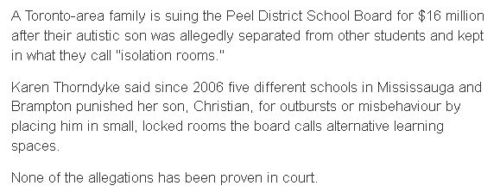
Retrieved from: http://www.cbc.ca/news/canada/toronto/autistic-boy-kept-in-isolation-rooms-at-peel-schools-lawsuit-alleges-1.2990024 April 13, 2015

Slide 8
calming room
Quiet chair
detention
Time-out
cool down
area
sensory
room
Thinking
Spot
ISS
Quiet Corner

Slide 9
Questions That Arise about Time-out
(When and why) are we using “time-out”?
What behaviours result in this consequence?
Where does the student go?
How is it determined when the student should go there?
What happens once the student gets there?
What really is the purpose of time-out?
Should time-out be used in schools?

Slide 10
What time-out really is . . .

Slide 11
What is Time-out?
Time-out from positive reinforcement
In behavioural terms, a punishment procedure
Does not necessarily require removal of the student
Continuum of strategies intended to reduce problem behaviour
  Non-exclusion (inclusion) time-out
  Exclusion time-out

Slide 12
Continuum of Time-out Applications
Inclusion time-out: planned ignoring
Inclusion time-out: withdrawal of materials
Inclusion time-out: contingent observation
Exclusion time-out in same room
Exclusion time-out in other supervised area

Slide 13
Non-exclusion Time-out
The student remains in the learning environment, but access to reinforcement is not available
Planned ignoring
Withdrawal of materials
Contingent observation

Slide 14
Exclusion Time-out
The student is removed from the reinforcing activity and is not permitted to participate in or watch the activity
May be in the same room, but where unable to see activity/classmates (physical space and set-up are considerations)
May be in another supervised location within the school

Slide 15
Time-out?
Just as important as understanding what time-out IS, is understanding what time-out IS NOT

Slide 16
Time-out?
Student working independently in a distraction-free environment?
  Danny
Individual one-to-one instruction or practice?
  Marco
Student requests to go to a separate area for a break?
  Paula

Slide 17
Time-out?
Having a student sit on a chair in the classroom away from classmates?
  Jack
Sending a student to sit or stand in the hallway?
  Lise
Sending a student to the principal’s office?
  Elizabeth
Sending a student to a separate room?
  Bradley

Slide 18
What does the research tell us about time-out?

Slide 19
Examining the research
Time-out procedures, if used correctly, can be effective in reducing a variety of problem behaviors, particularly with younger students
Less intrusive time-out strategies may be as effective, or more effective, than more intrusive strategies for reducing some behaviours
The function of the behaviour matters

Slide 20
(Where) does time-out fit in an intervention plan?

Slide 21
Considerations
School-wide positive behaviour supports
Some types of less restrictive, inclusionary time-out strategies are used on a regular basis in schools
Provincial policies, guidelines, documents and terminology

Slide 22
Top Tips
Don’t interact with the student in time-out
Don’t talk about the student in front of him/her
Don’t have a conversation on any topic, with anybody, while you are supervising the student

Slide 23
Top Tips
When it’s over, it’s over
Reinforce desirable behaviours as soon as possible
  set up the opportunity for desirable behaviour to happen
  enrich the time-in environment
Research doesn’t support a lengthy time-out
  1-4 minutes often effective
  Less lost teaching time and more time to reinforce desired behaviours

Slide 24
If a time-out procedure is being considered, research indicates that there are a number of key factors to consider.

Slide 25
Key Factors
Involve Student Support / Educational Support Services teams and families
Define the behaviour(s) leading to time-out
Determine the function of the behaviour. Is a time-out procedure an appropriate intervention to consider?
Weigh the risks

Slide 26
Key Factors
Decide on the appropriate type of time-out
Identify the behaviour you want to see instead
Combine time-out with positive approaches to teach and reinforce the replacement behaviour
Remember, time-out alone can never increase desired behaviours.

Slide 27
Key Factors
Obtain informed consent
Enrich the “time-in” environment
Define the procedures for the duration of time-out
Select the location for the time-out

Slide 28
Key Factors
Explain the time-out rules
Apply time-out consistently and appropriately
Decide on the data collection system and procedure
Monitor and review regularly

Slide 29
Seclusion and Physical Restraint

Slide 30
What is Seclusion?
“Time-out” and “seclusion” are not the same thing
Definition of seclusion

Slide 31
Guidelines from Professional Organizations
Council for Exceptional Children (2010). “CEC’s Policy on Physical Restraint and Seclusion Procedures in School Settings.”
Ontario Association for Behaviour Analysis, Inc. (2013). “Statement on the Use of Restraint and Seclusion.”
Association for Behavior Analysis International (2010). “Statement on Restraint and Seclusion.”

Slide 32
Seclusion
Substantial and imminent risk
As a last resort
Only as long as necessary
Staff should have knowledge and training

Slide 33
Seclusion (cont’d)
The literature recommends that emergency seclusion procedures should not be used when . . .
The substantial safety risk no longer exists
Any known medical, physical, or psychological condition would make the procedures dangerous for that student
The student is engaging in self-injury (without adequate protection)

Slide 34
Seclusion (cont’d)
Experts tend to recommend that emergency seclusion procedures should be limited to situations in which . . .
an individual is engaging in behaviour that presents a substantial and imminent risk to himself/herself or others
a behavioural outburst happens unexpectedly and safety must be maintained in that moment
In rare situations where frequent violent behaviour is anticipated, additional planning and supports are required.

Slide 35
Take-away Messages

Slide 36
Keep in Mind . . .
Time-out involves a continuum of strategies
When used effectively, time-out reduces or stops a behaviour by removing access to a reinforcing item, event, situation, person
Provincial and school board/district policies and guidelines

Slide 37
Keep in Mind . . .
Time-out is, by definition, a behaviour-reduction strategy; as such, it can only be used to reduce undesirable behaviours
Time-out alone can never teach new, alternative, desirable behaviours
Consent, documentation, and ongoing monitoring

Slide 38
For More Information
Autism in Education Information Paper
  apsea.ca/aie
Provincial policies and guidelines
Provincial Directors of Student Services/Education Services and Provincial ASD Consultants/Learning Specialists

Slide 39
“Current Research Regarding Time-out” / « Recherches actuelles concernant le temps de retrait» information paper may be found in English and French on the Autism in Education website at: apsea.ca/aie
Questions?

Slide 40
Terms of Use
This PowerPoint presentation, along with the Autism in Education information papers, may be distributed and used for educational purposes and/or staff training. No changes to the content of this presentation should be made without written permission from APSEA’s Autism in Education Advisory Committee.

